Slide 1
Understand Kotlin Coroutines
Subramanian Murugan

Slide 2
What problems are coroutines trying to solve

Slide 3
Coroutines simplify async code by replacing Callbacks

Slide 4
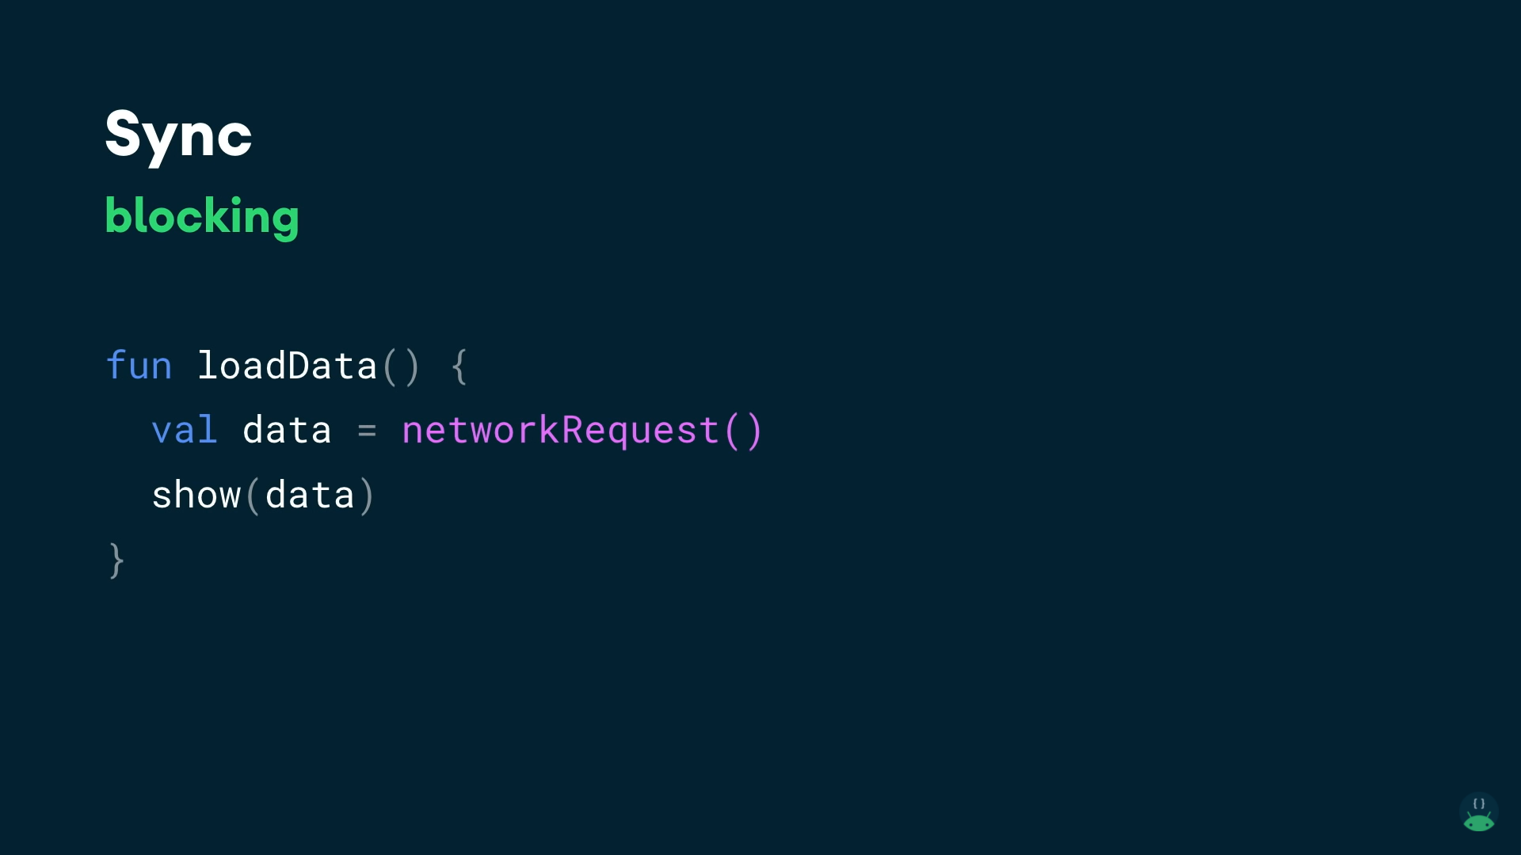

Slide 5
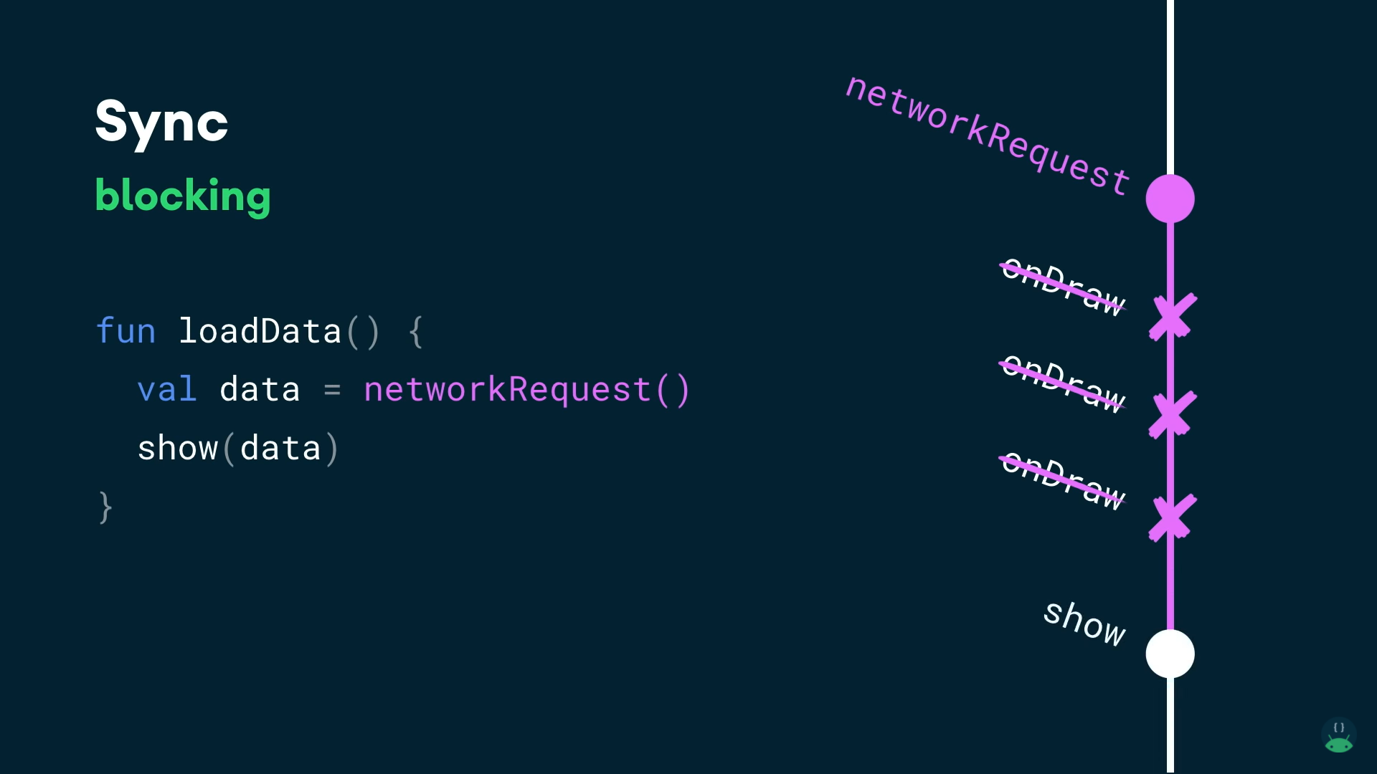

Slide 6
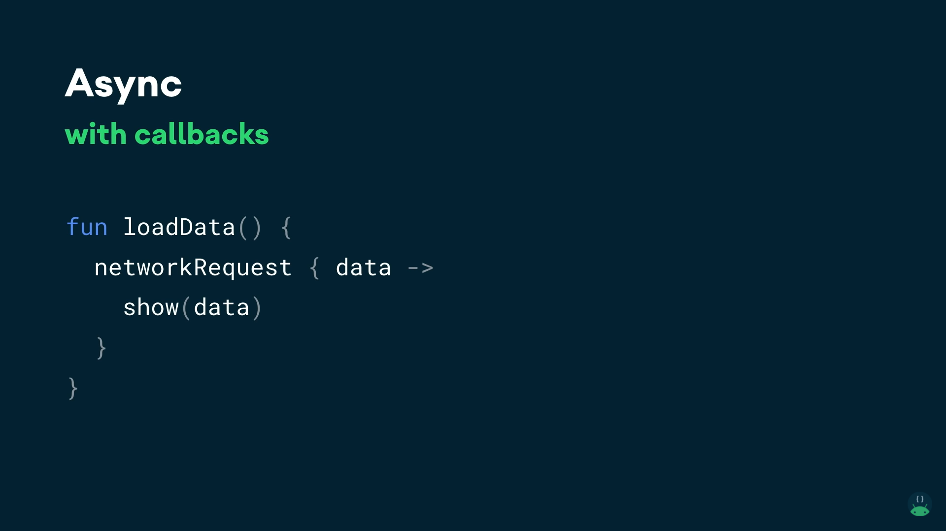

Slide 7
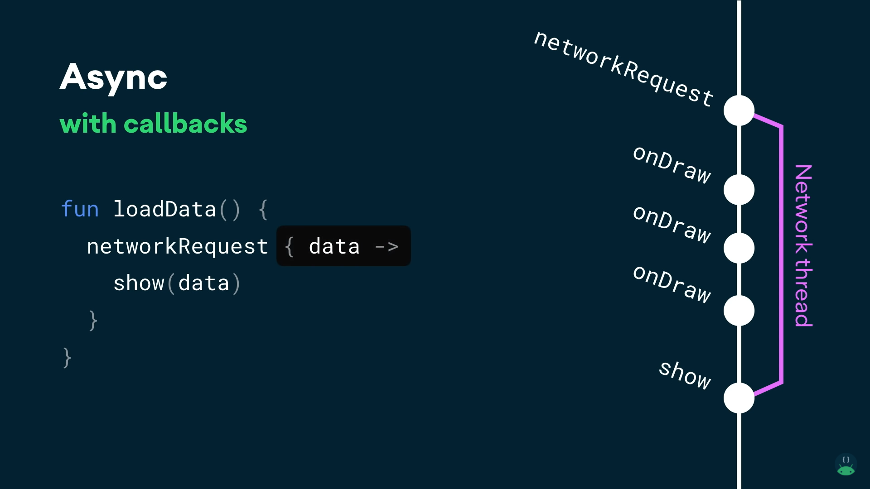

Slide 8
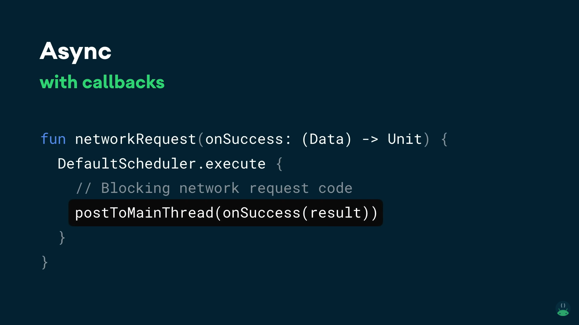

Slide 9
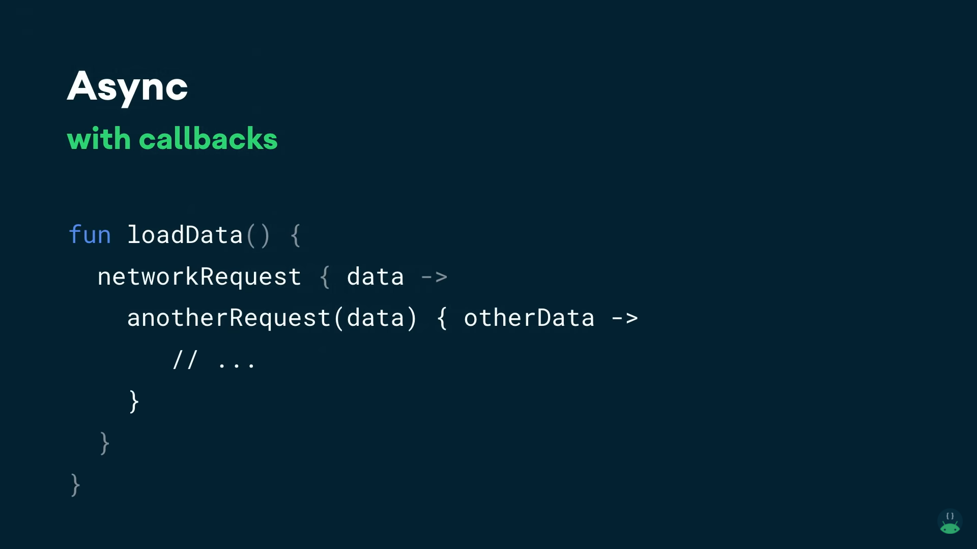

Slide 10
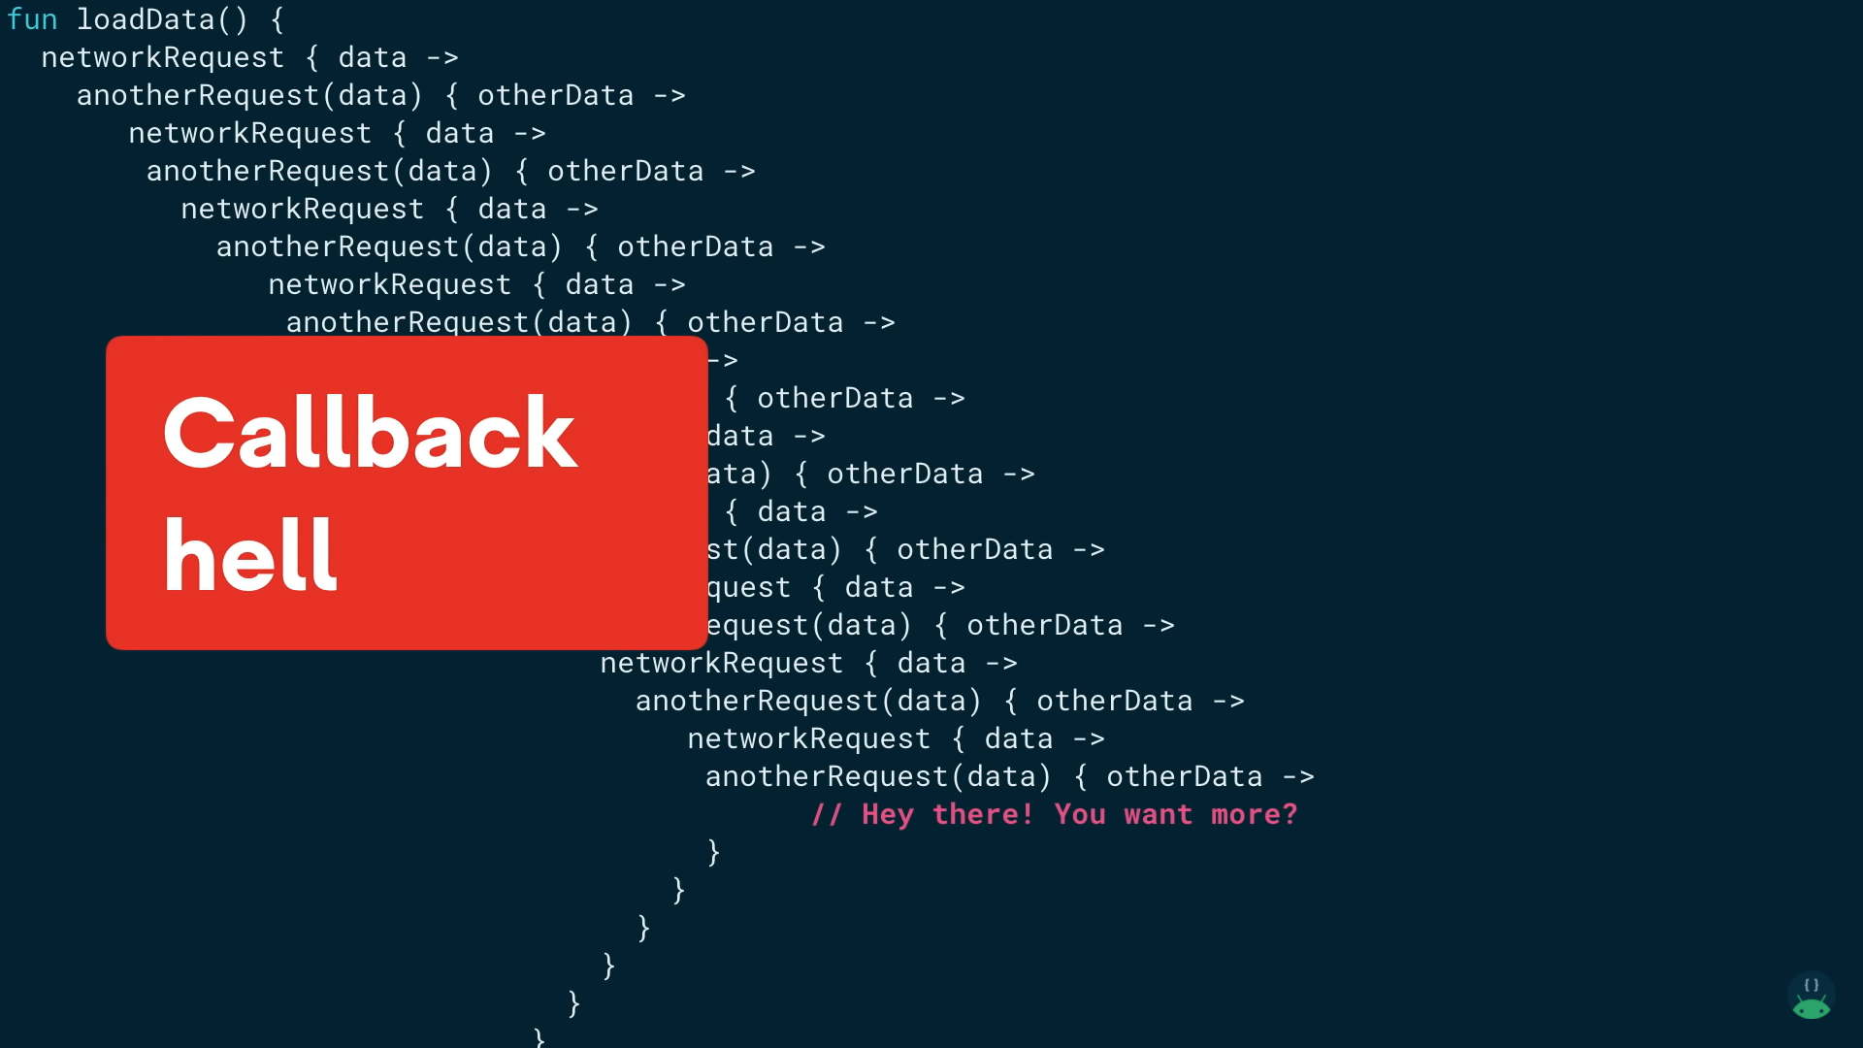

Slide 11
Callbacks ?
The Kotlin compiler writes them under the hood when the computation can suspend

Slide 12
Continuation
Coroutines call those “callbacks” continuation

Slide 13
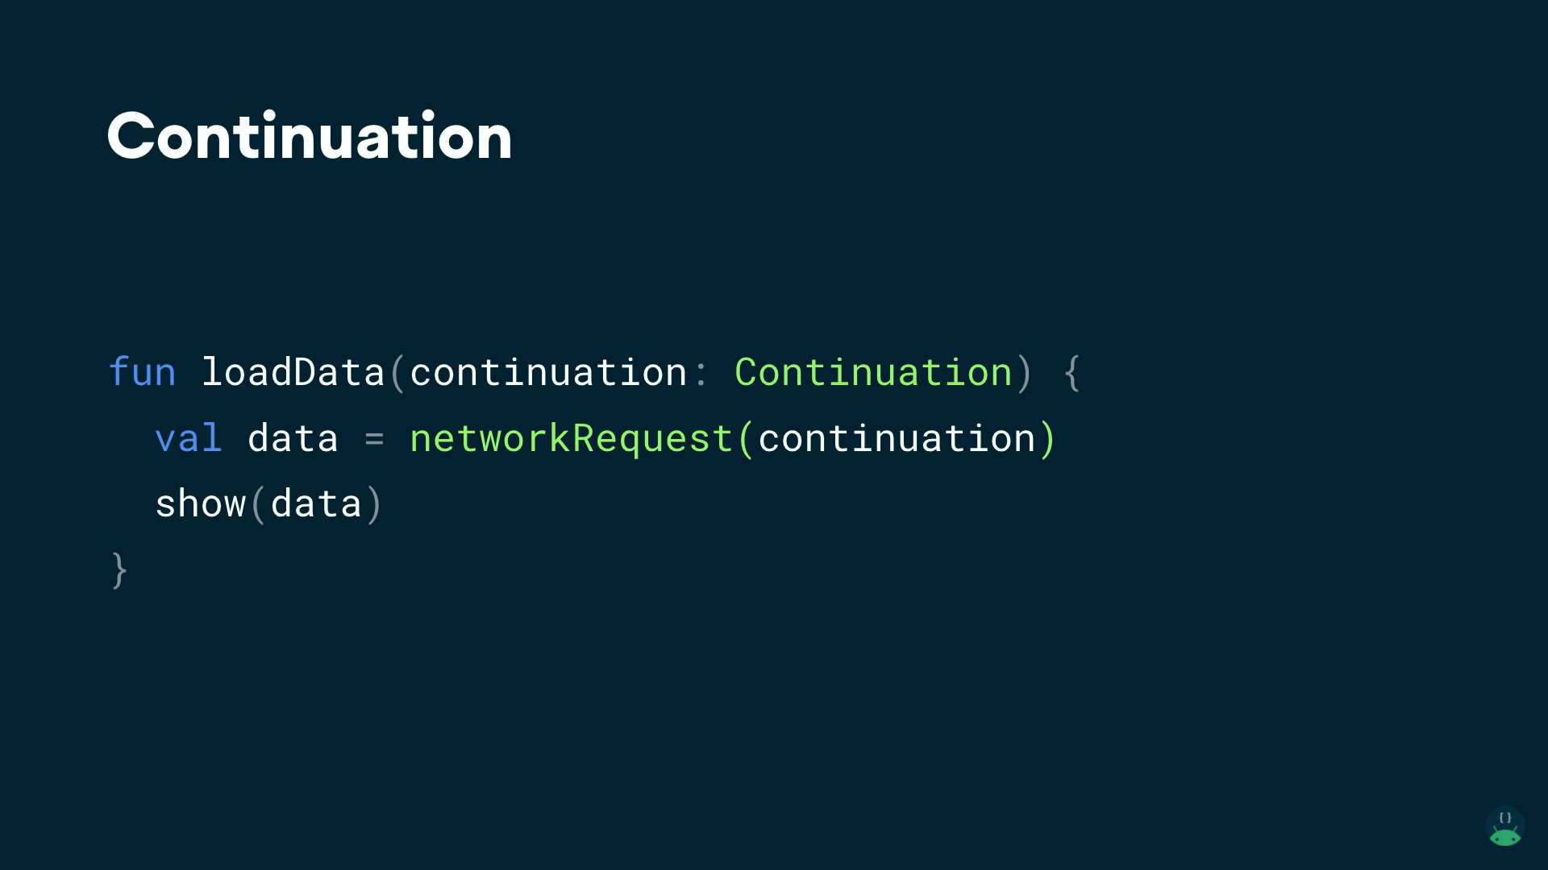

Slide 14
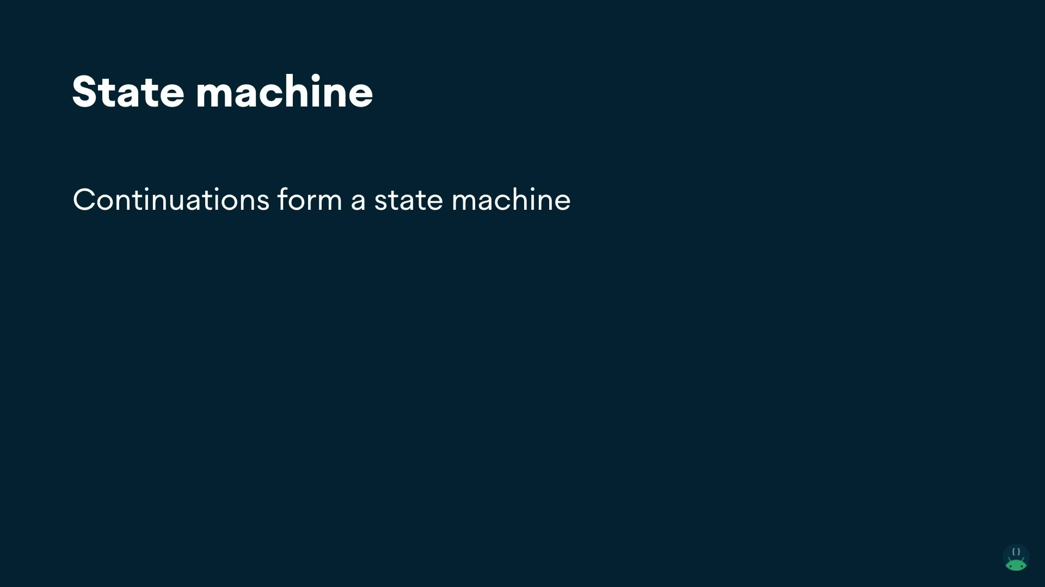

Slide 15
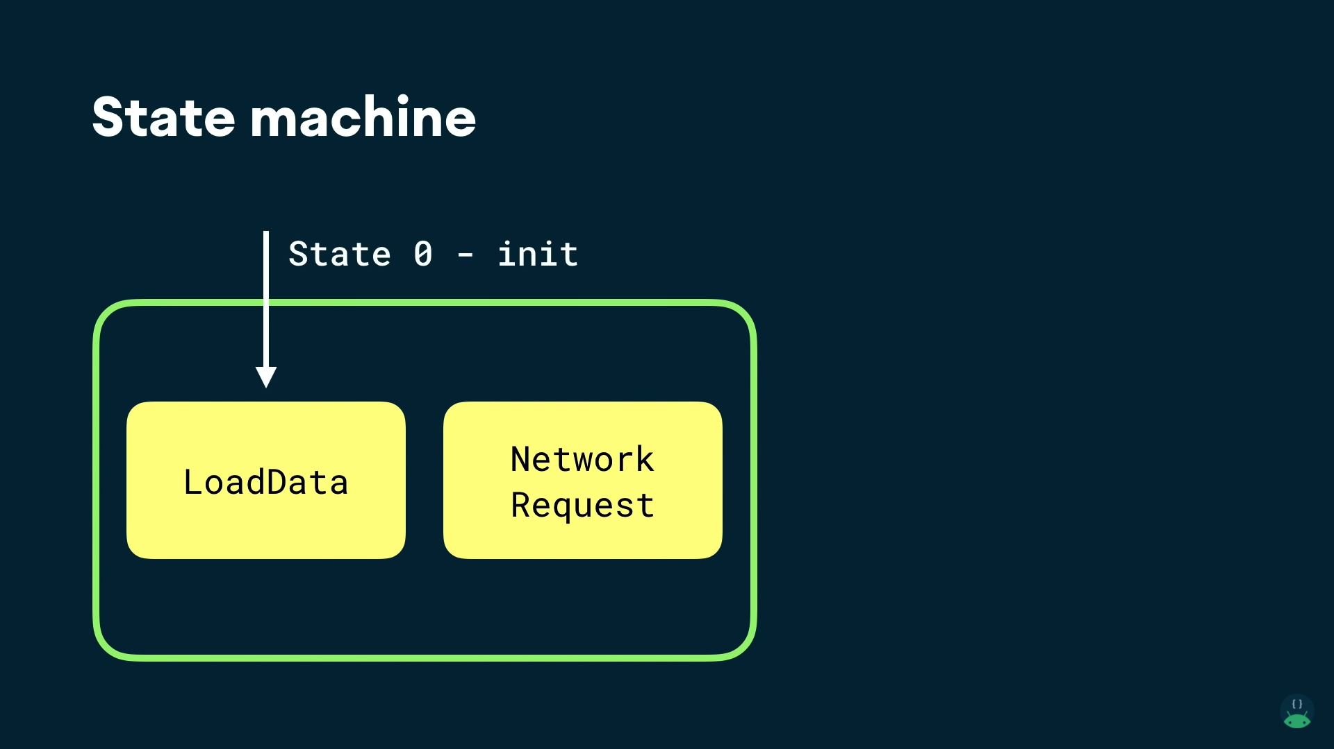

Slide 16
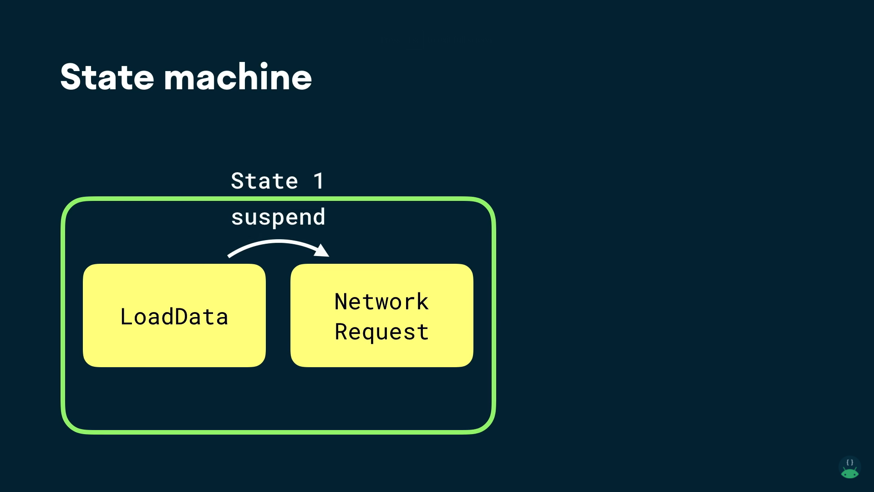

Slide 17
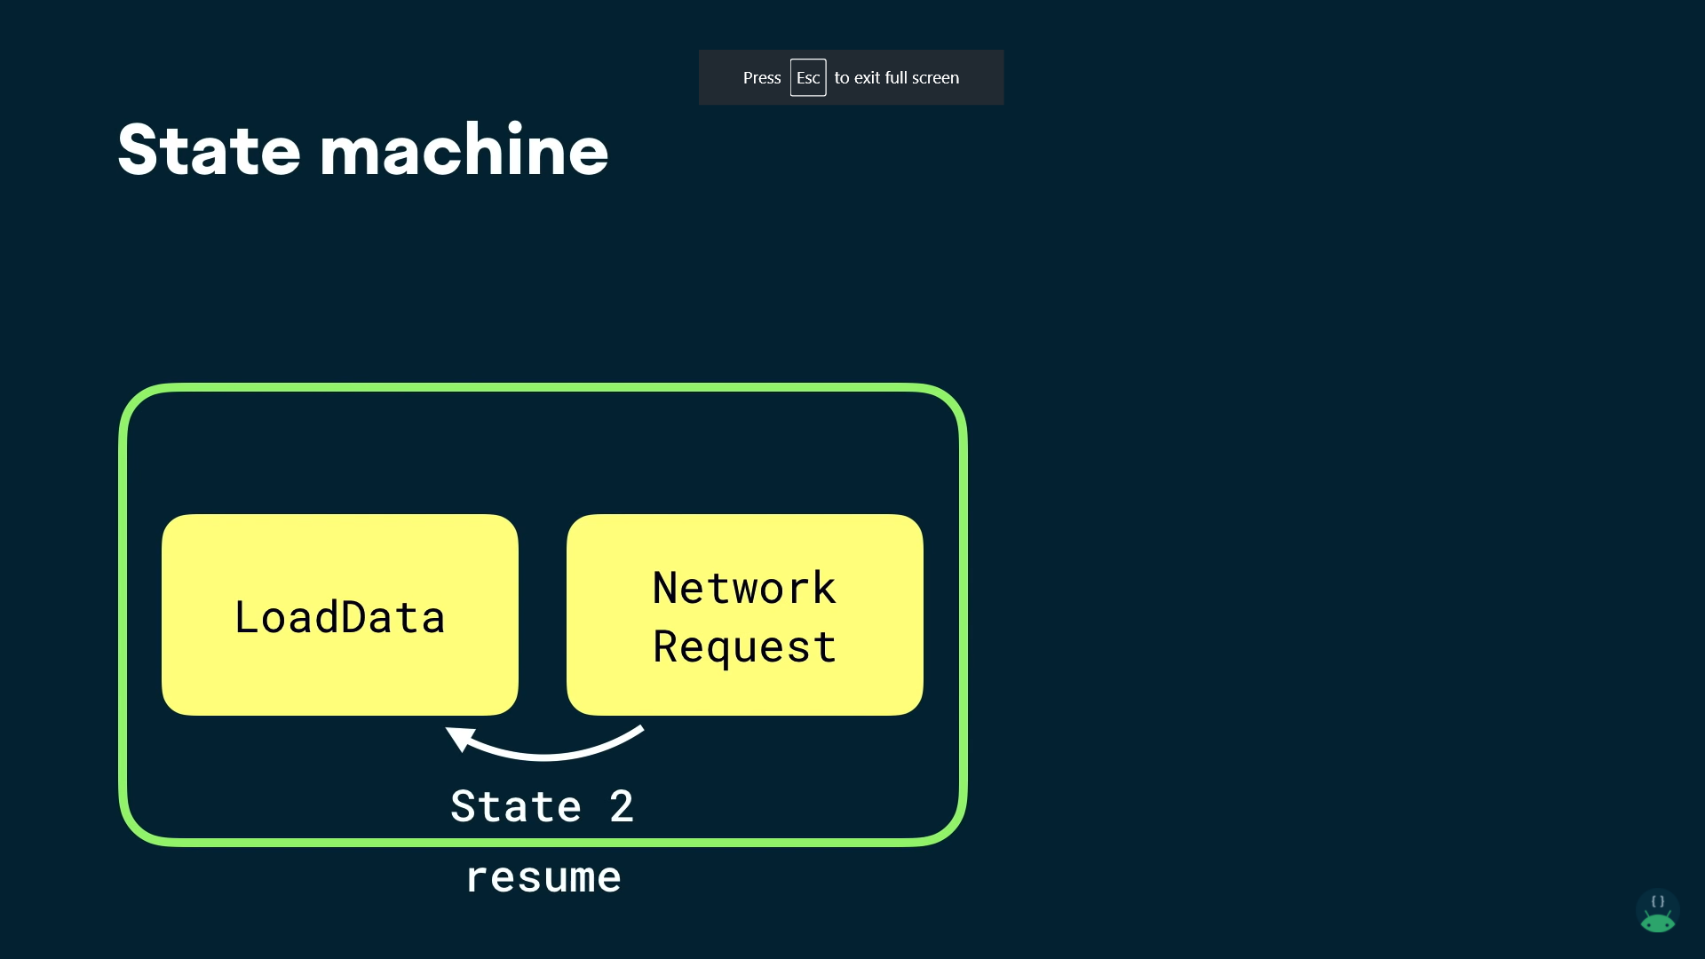

Slide 18
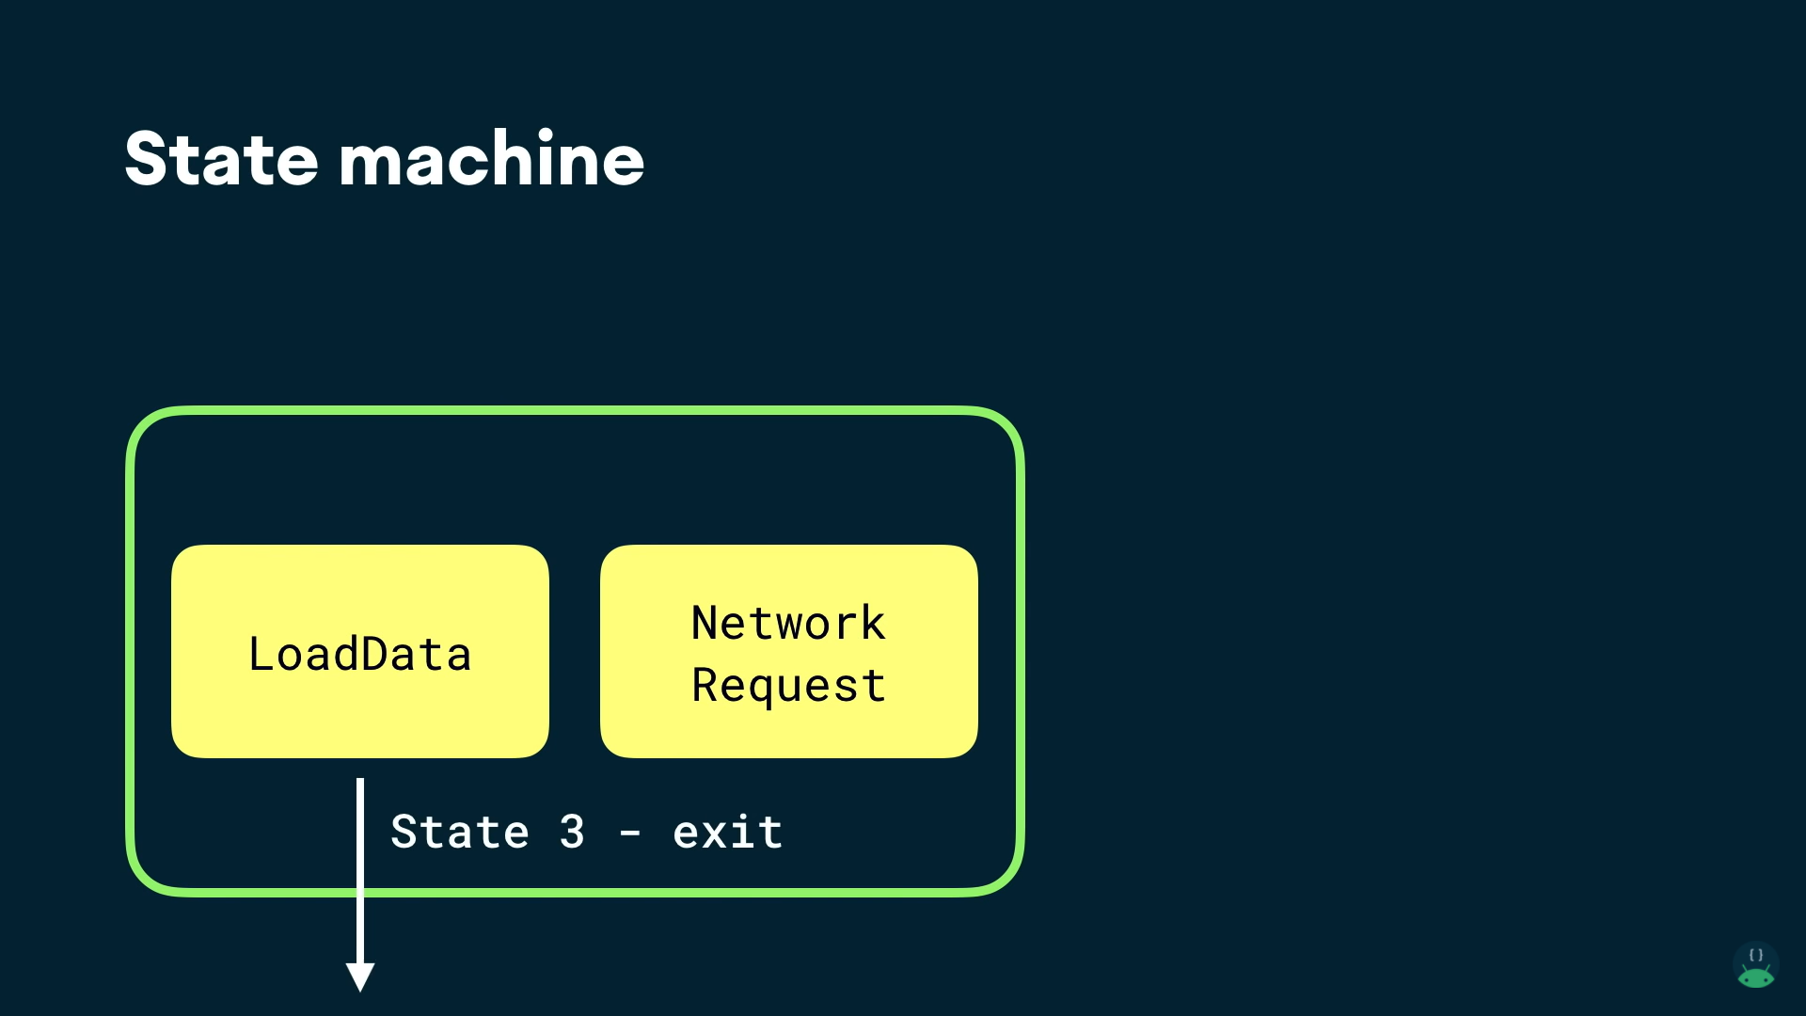

Slide 19
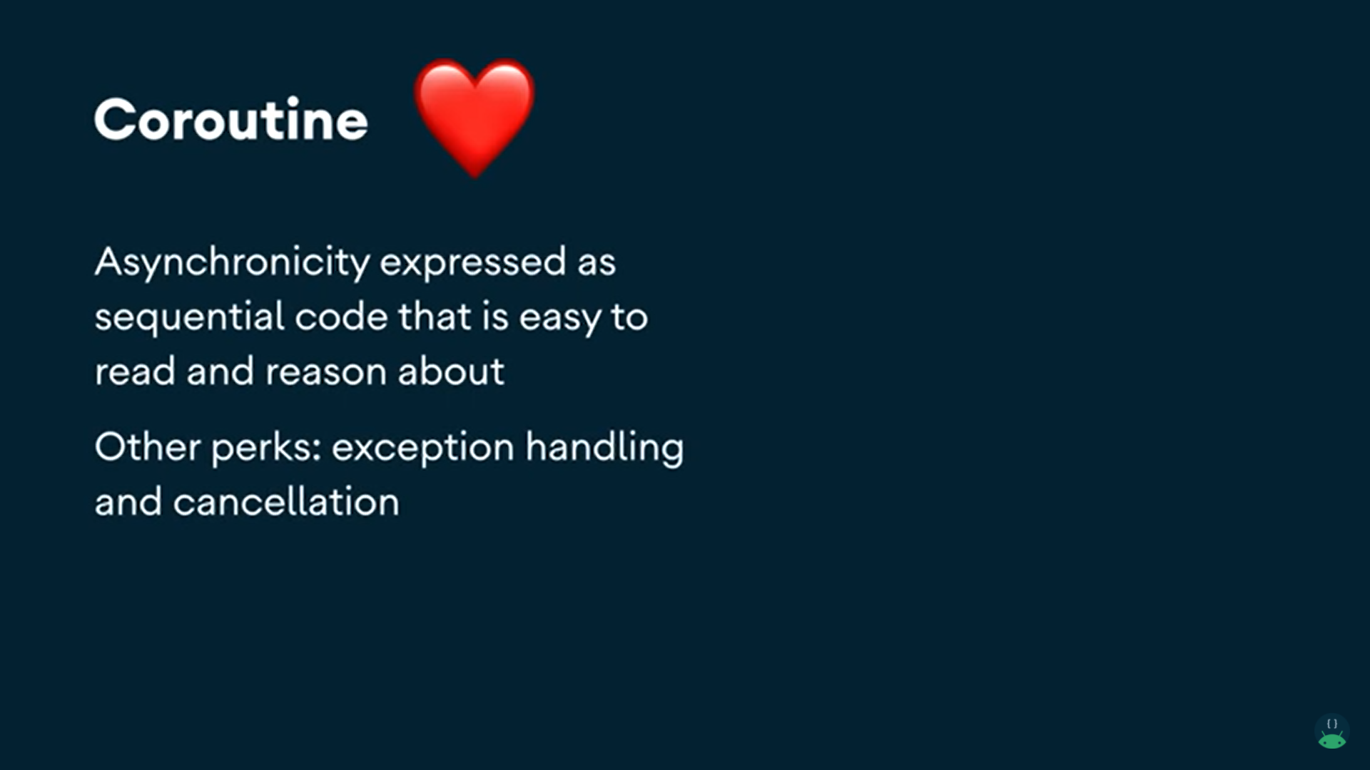

Slide 20
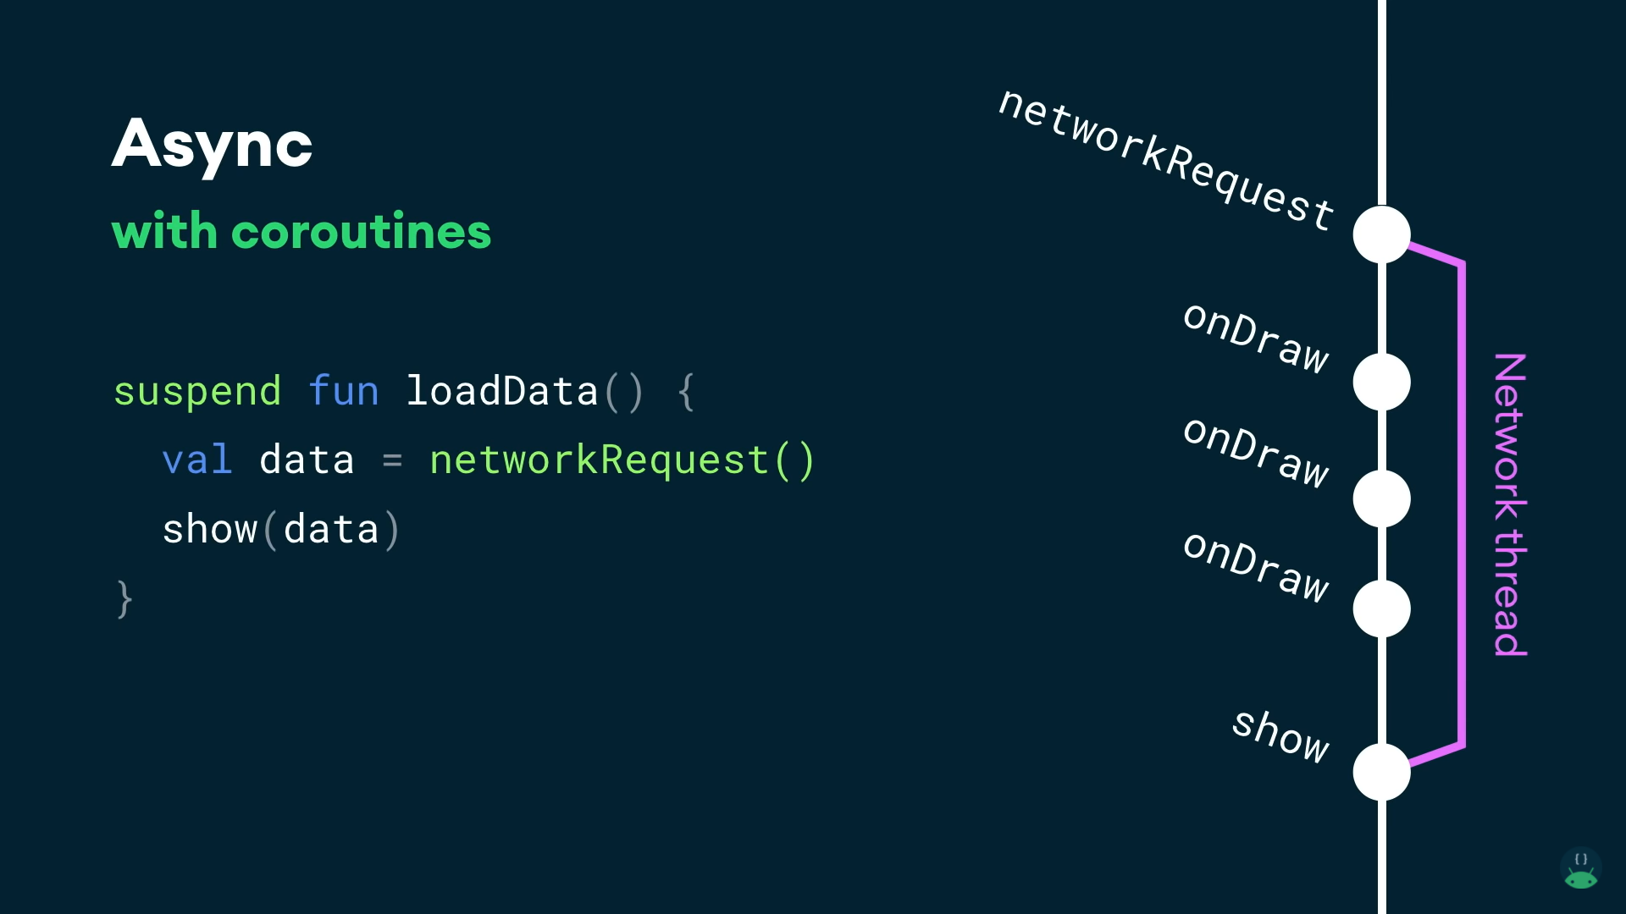

Slide 21
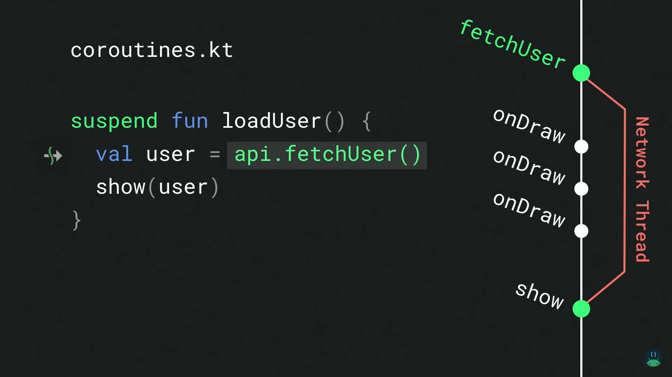

Slide 22
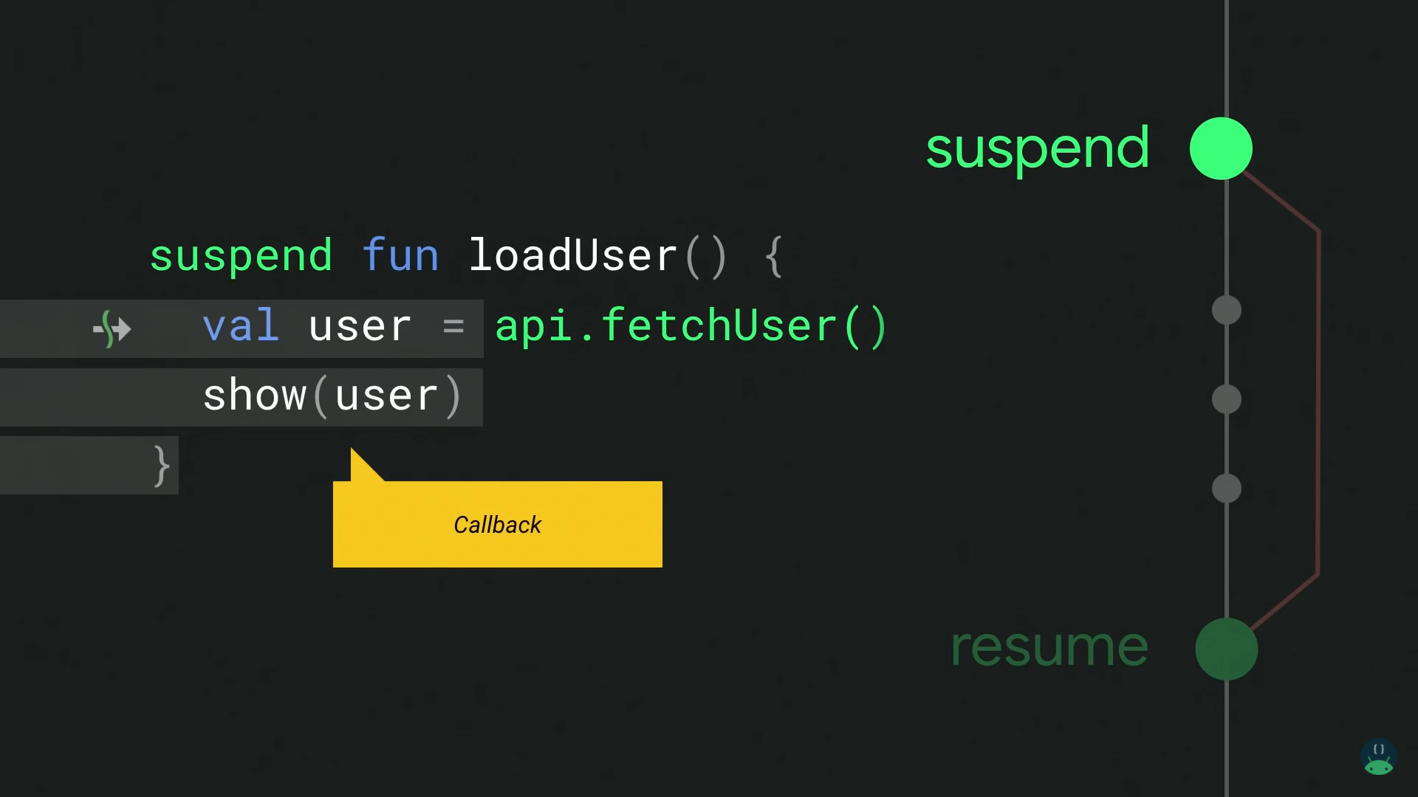

Slide 23
Suspend and resume replace callbacks

Slide 24
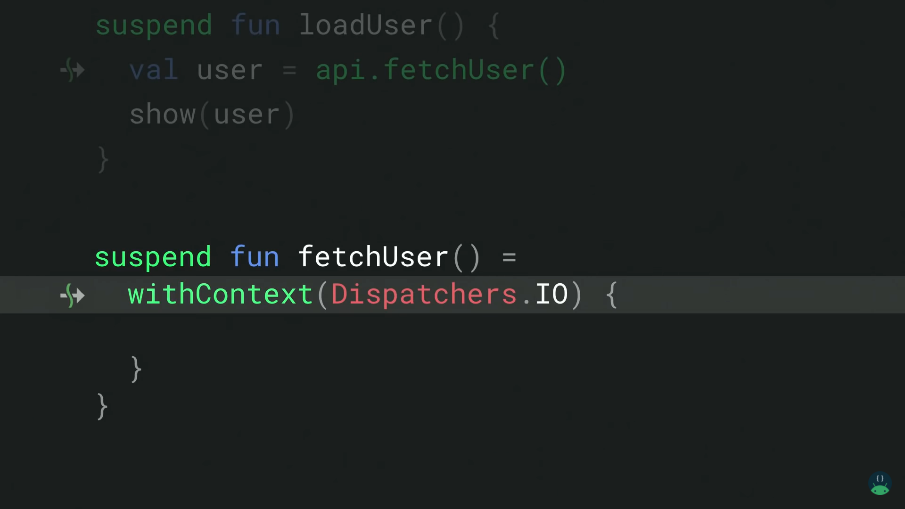

Slide 25
Dispatchers
Default

Slide 26
Dispatchers
IO

Slide 27
Dispatchers
Main

Slide 28
Dispatchers
Default
CPU intensive

Slide 29
Dispatchers
IO
Blocking Network and disk io

Slide 30
Dispatchers
Main
UI Tasks

Slide 31
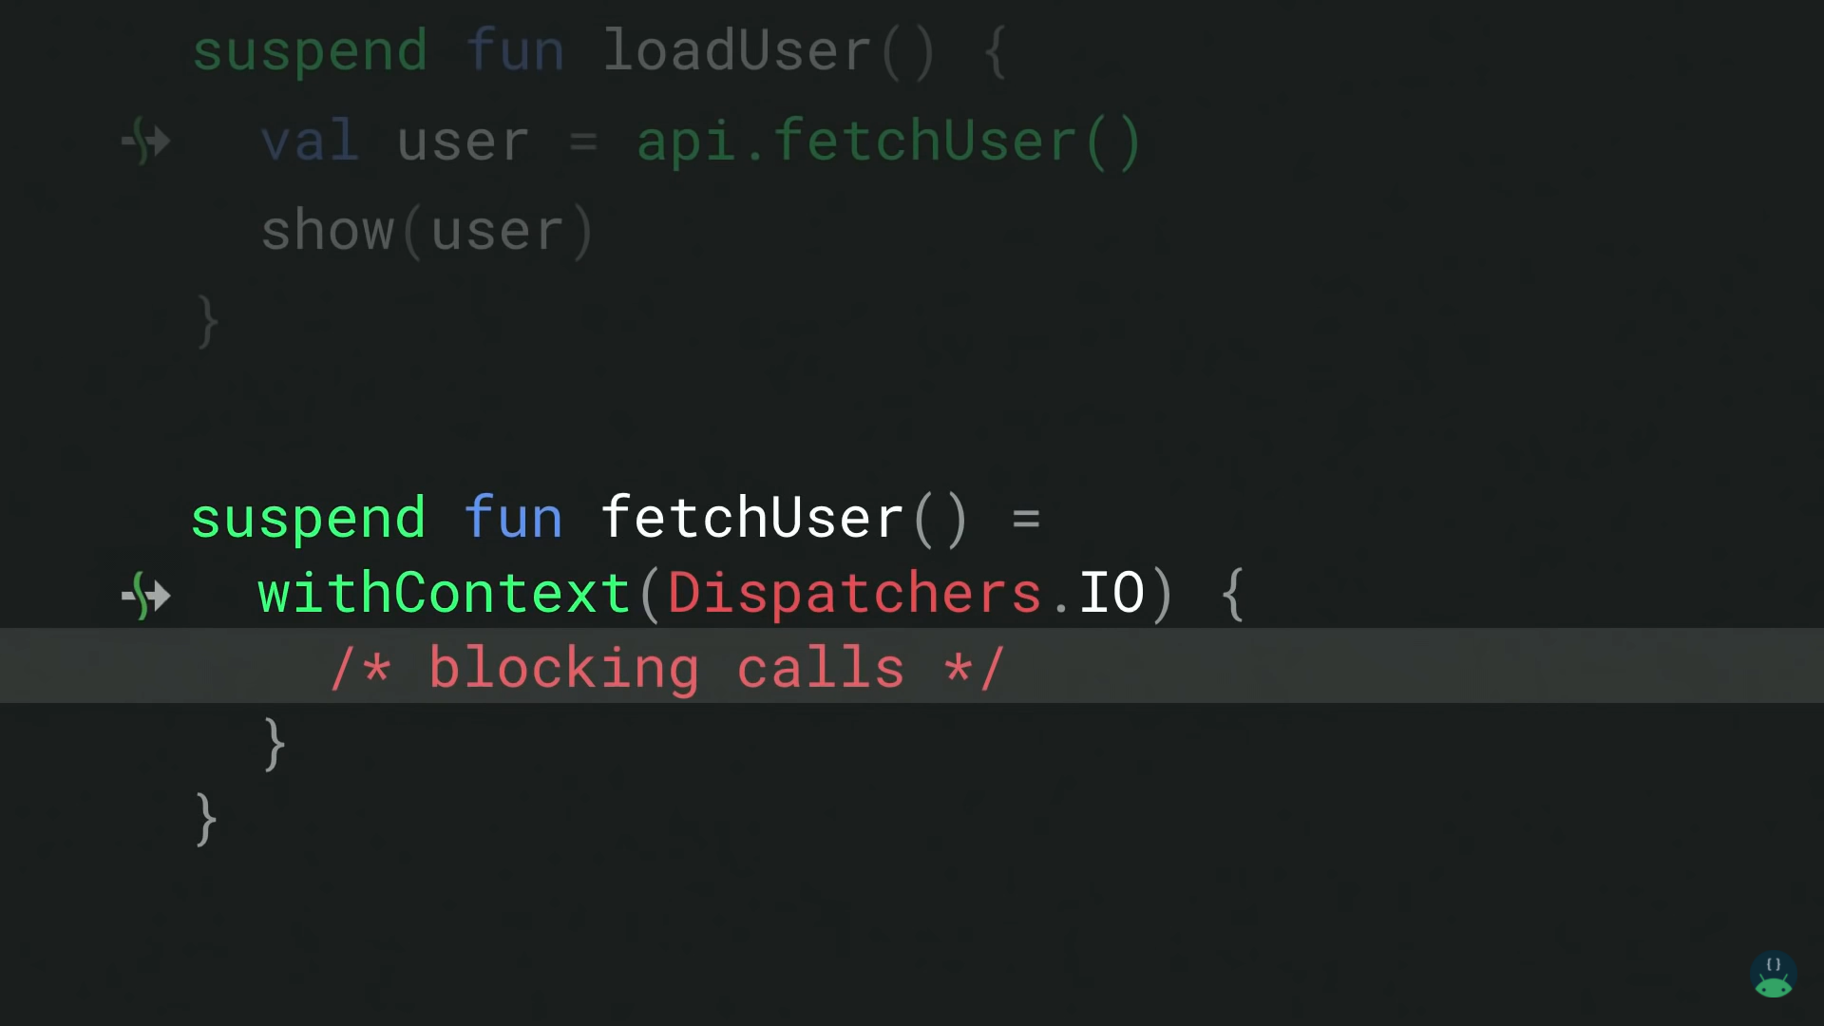

Slide 32
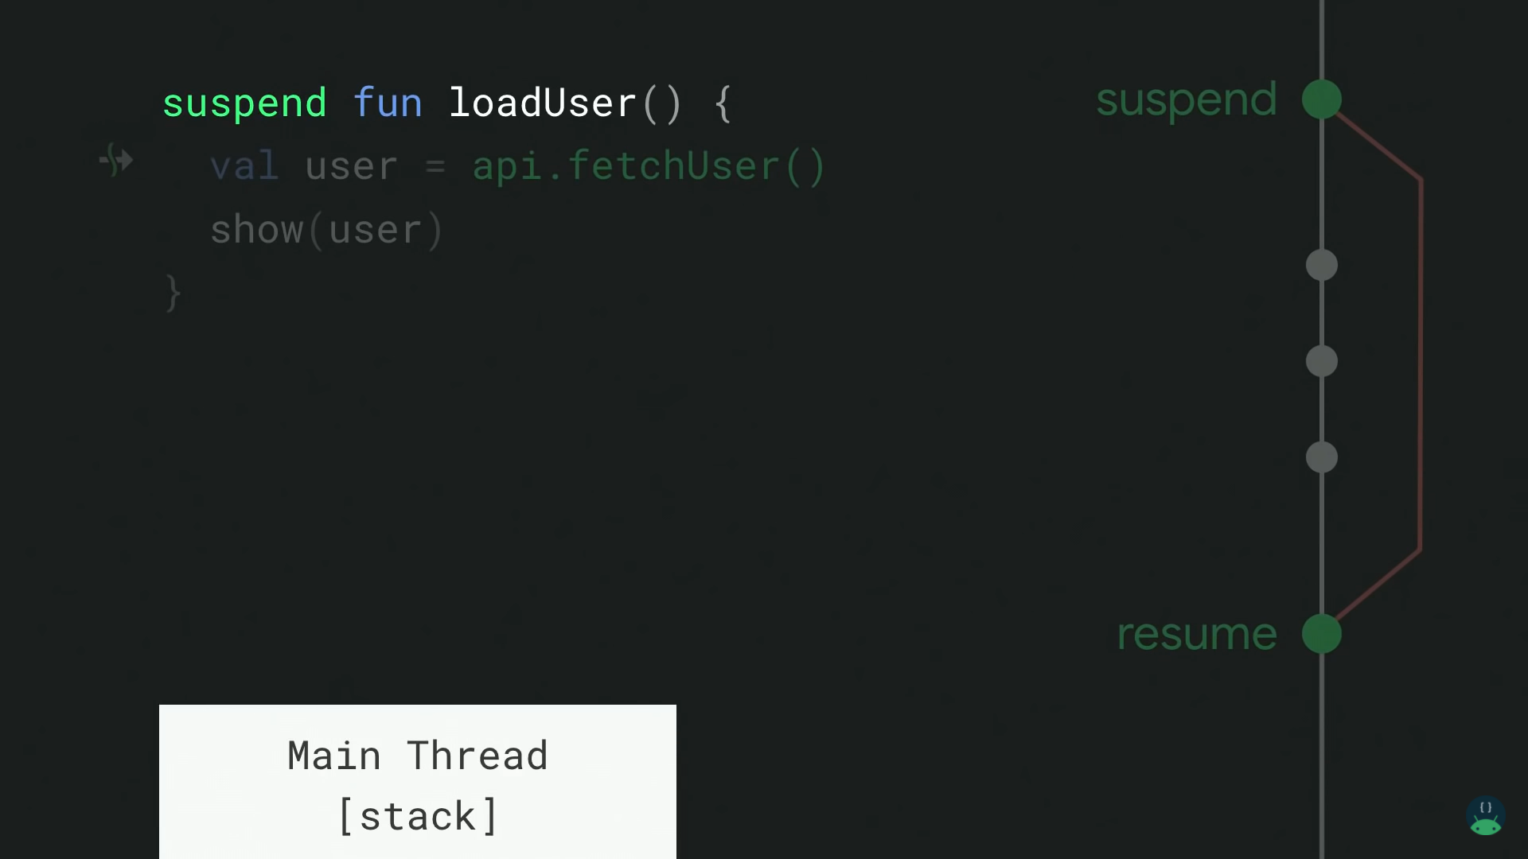

Slide 33
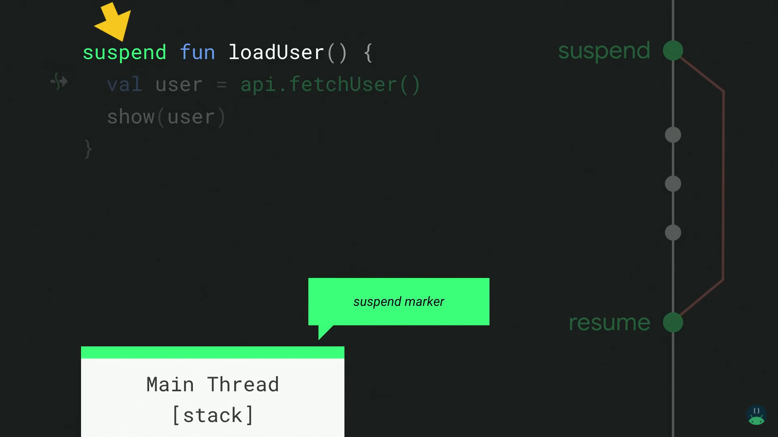

Slide 34
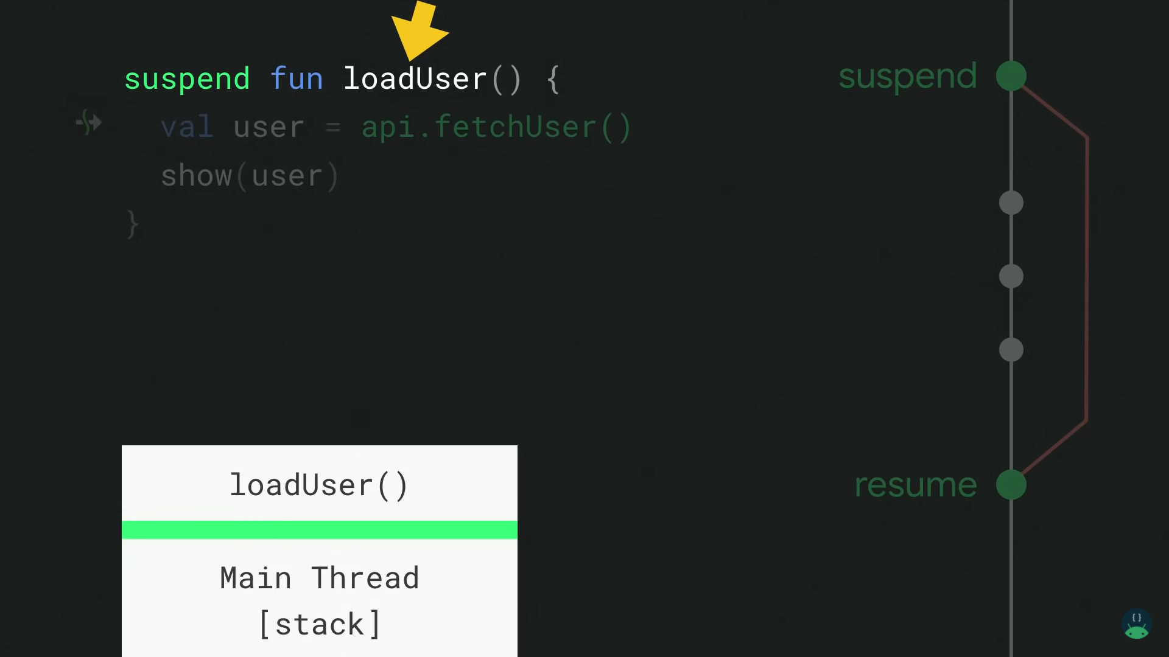

Slide 35
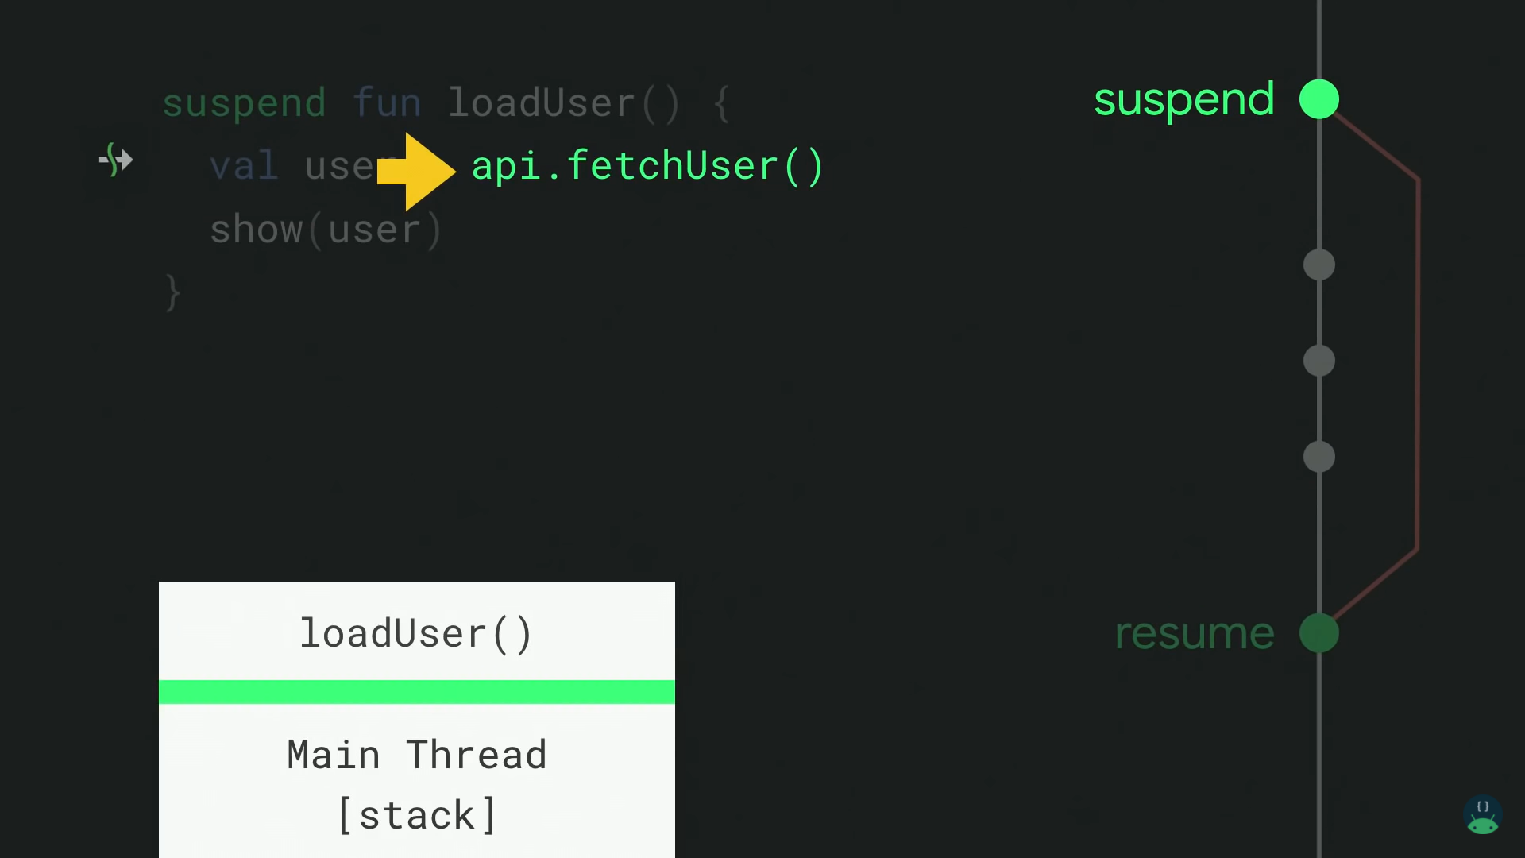

Slide 37
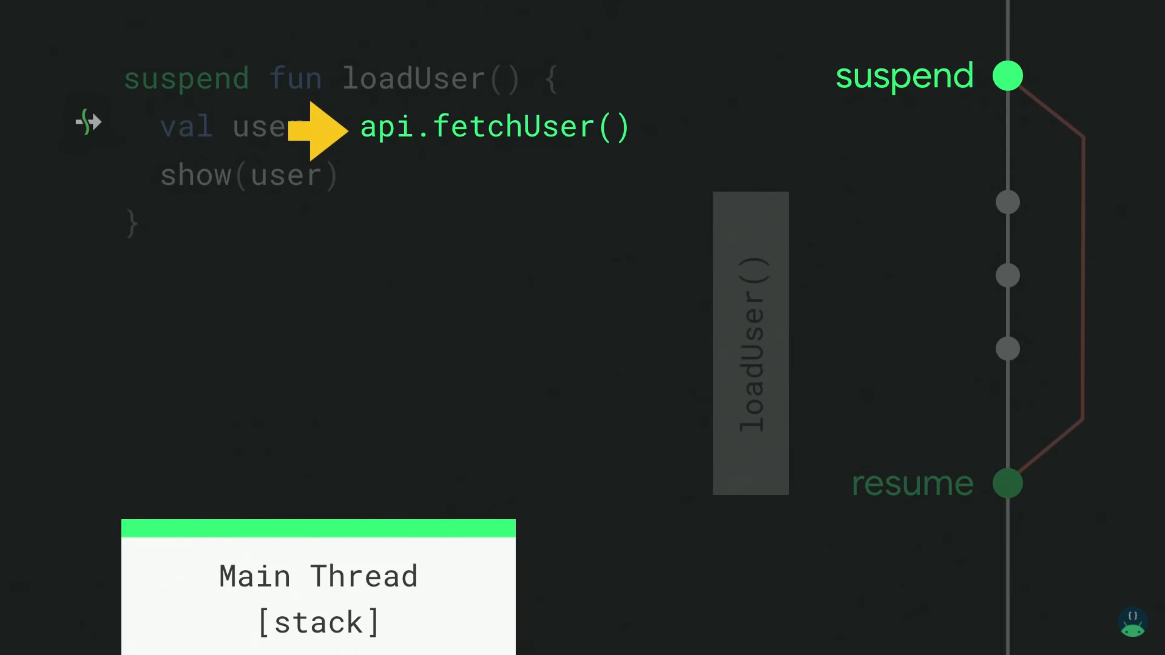

Slide 38
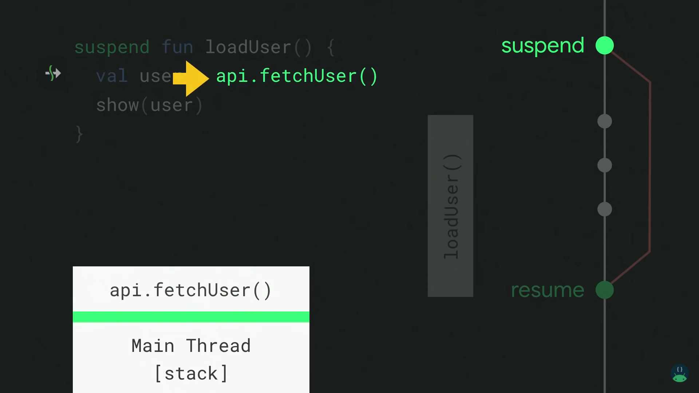

Slide 39
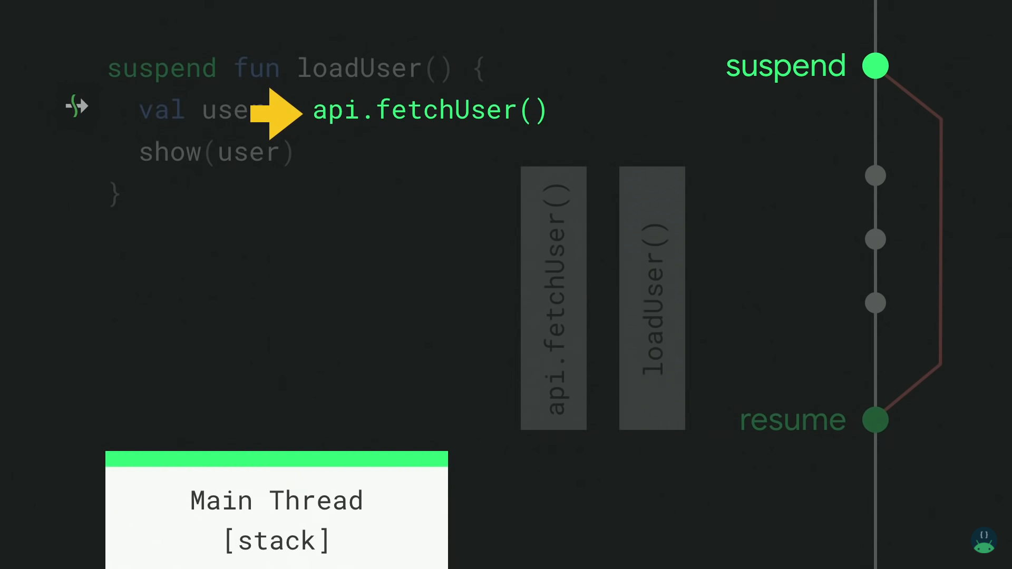

Slide 40
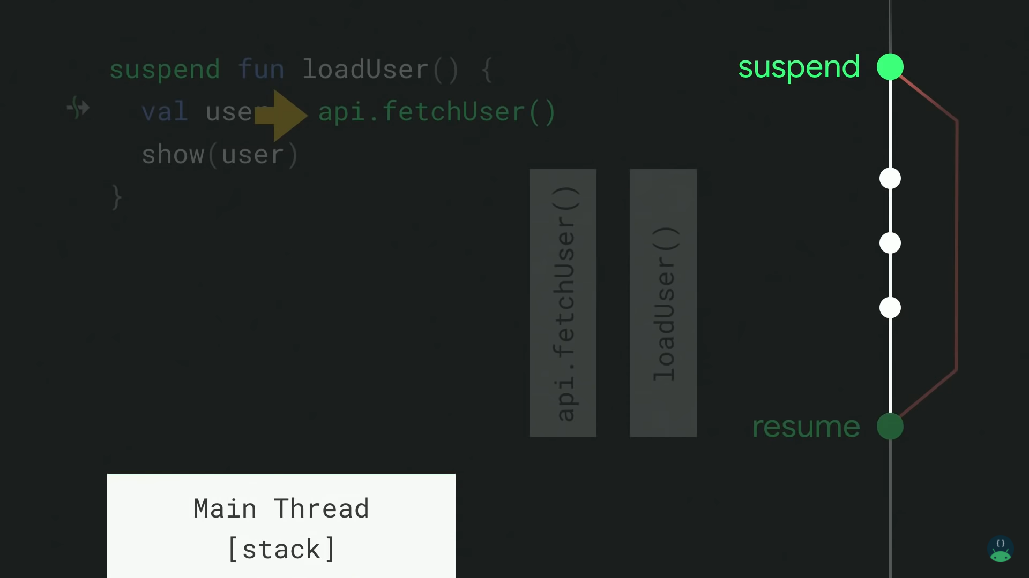

Slide 41
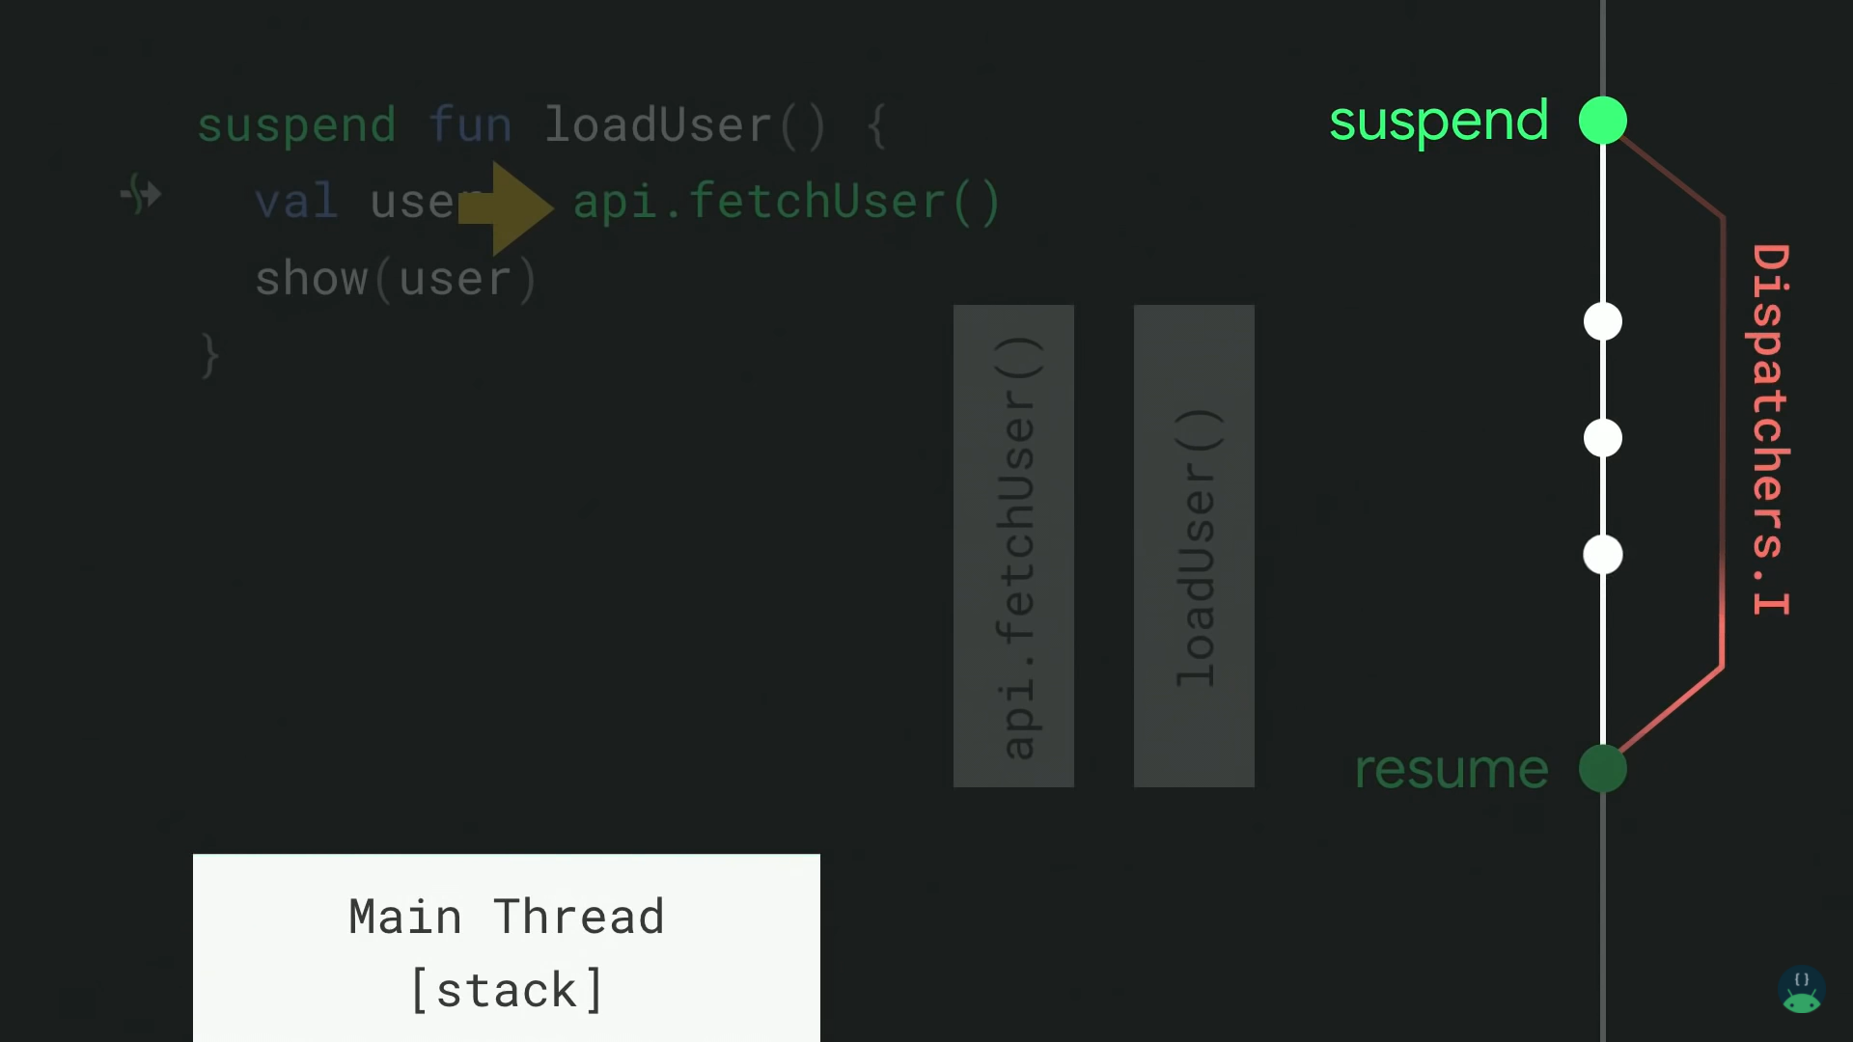

Slide 42
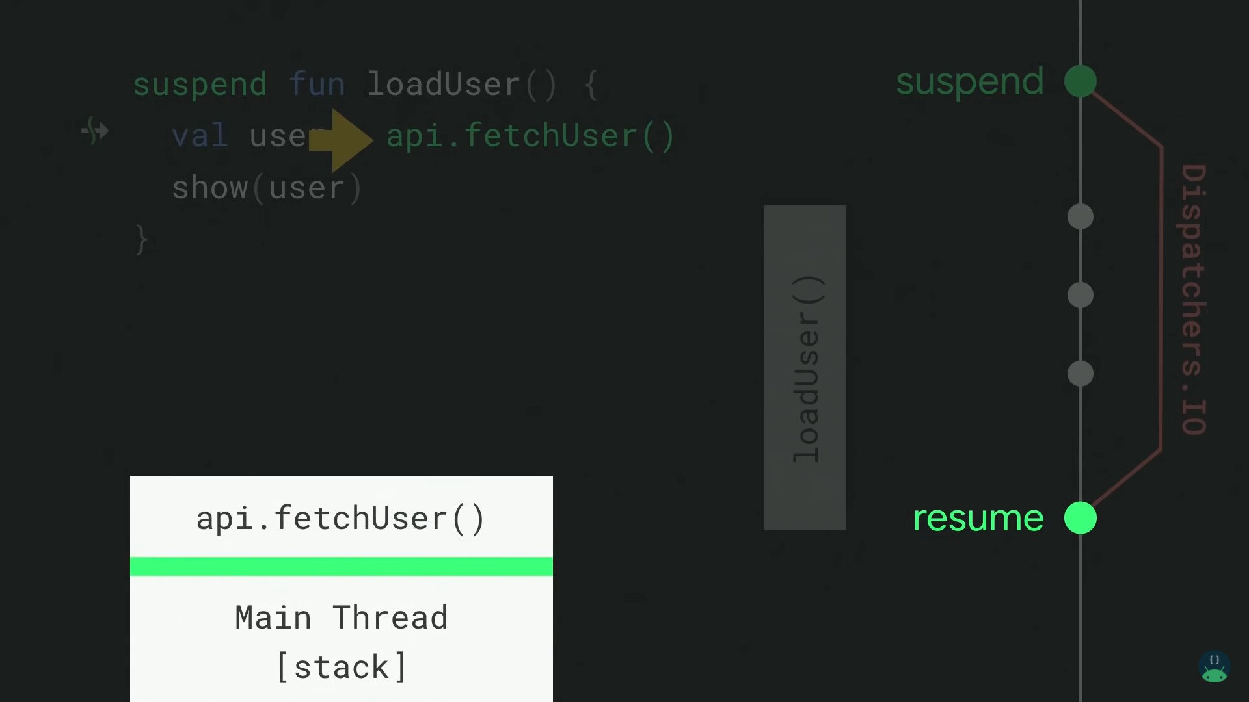

Slide 43
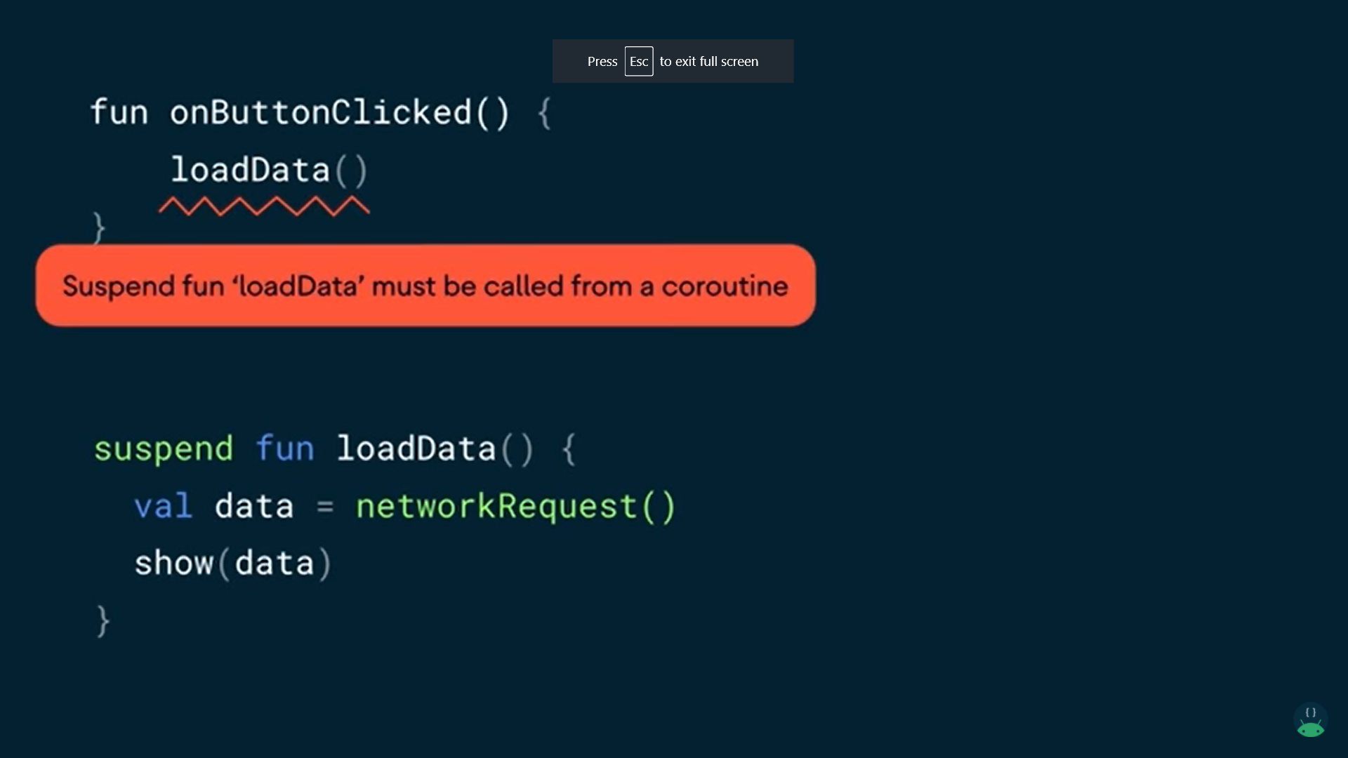

Slide 44
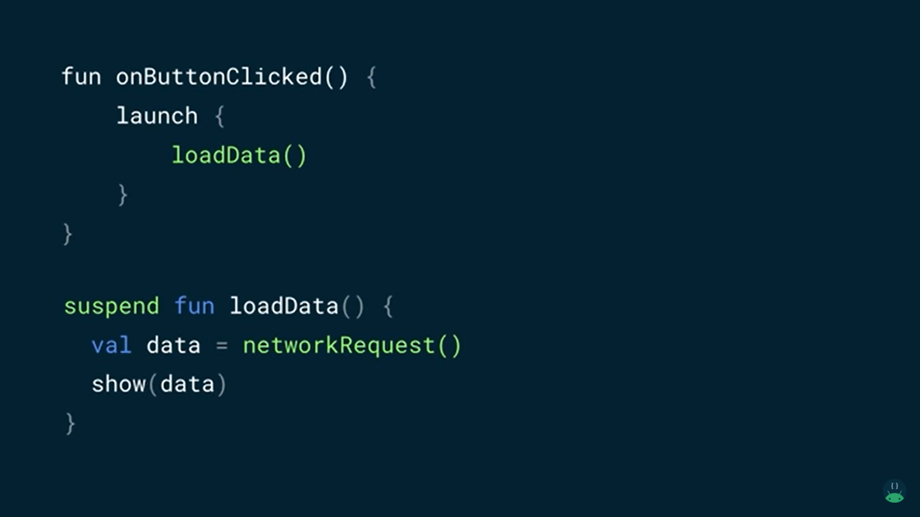

Slide 46
Structured concurrency﻿
Coroutines follow a principle of structured concurrency which means that new coroutines can be only launched in a specific CoroutineScope which delimits the lifetime of the coroutine

Slide 47
Scopes
Keep track of coroutines
Ability to cancel them
Is notified of failures

Slide 48
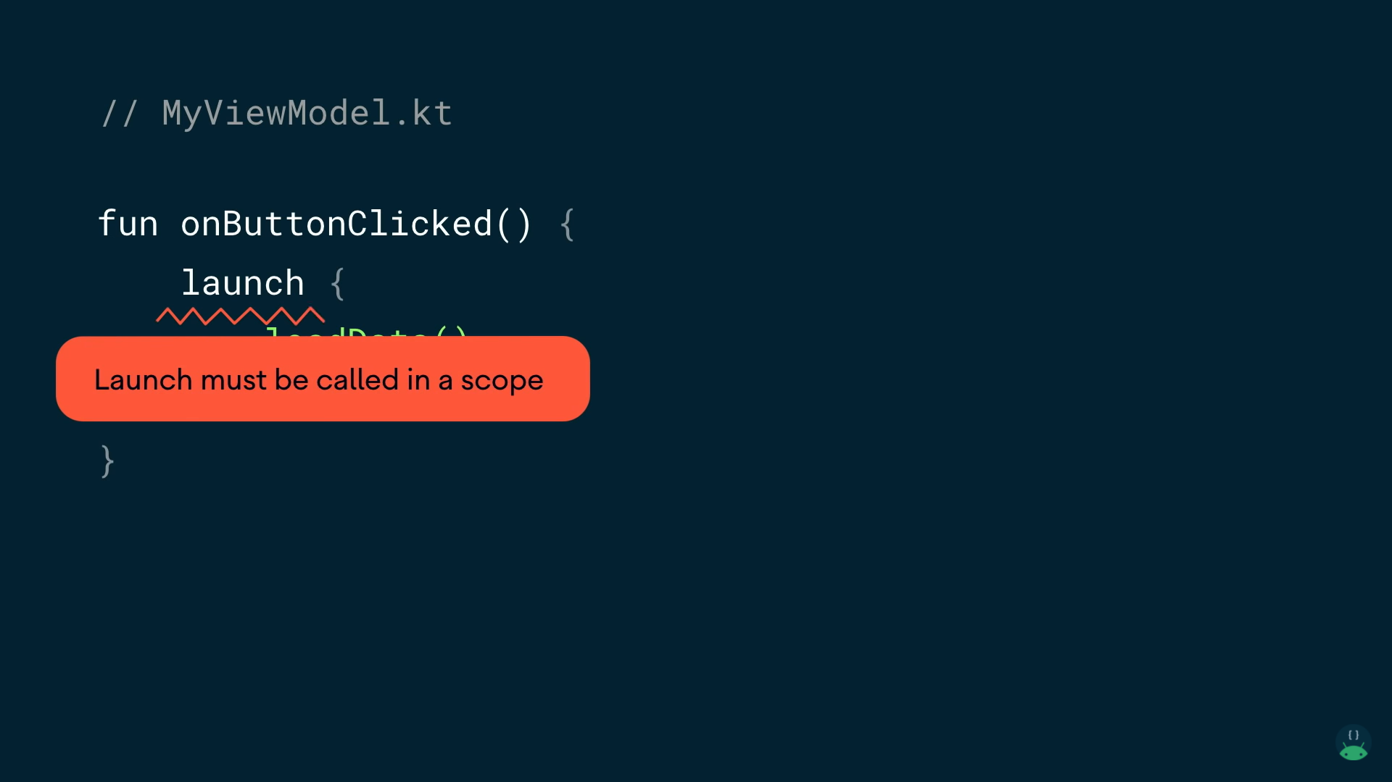

Slide 49
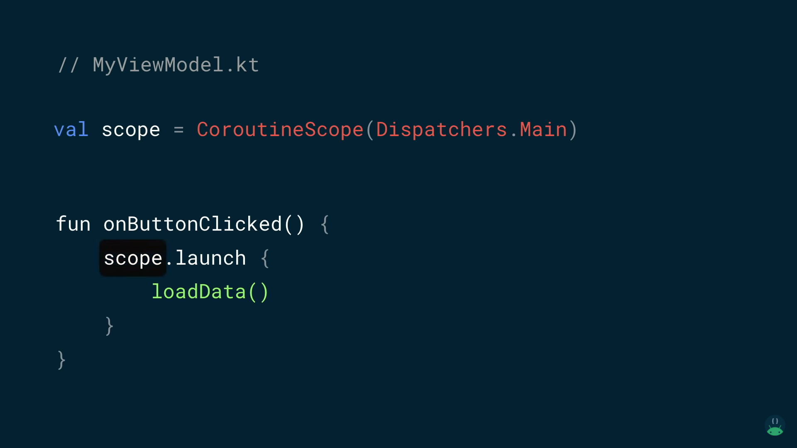

Slide 50
